Slide 1

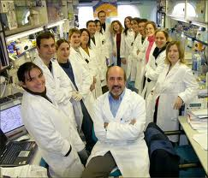

Technology Transfer 101:
Taking Discoveries from Lab Bench to the Marketplace
Title here

Slide 2
What is AUTM?
The volunteer organization that brings together over 3000 technology transfer professionals in more than 30 countries to support and advance academic technology transfer globally.
65% are employed in academic technology transfer
35% are in industry

Slide 3
Membership Profile
76.5% USA
6.8% Canada
16.7% Rest of the World
The Rest of the World is the fastest growing part of the membership (23% average over last ten years)

Slide 4
Professional Development
Advocacy
Metrics and Surveys
Website
Annual Meeting
Regional Meetings
Global Technology Portal (GTP)!

Slide 5
What IS Technology Transfer?
aka Technology Commercialization, Technology Development

Slide 6

In the beginning…..

Slide 7






Basic Research

Slide 8


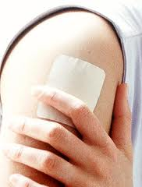
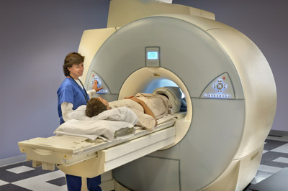
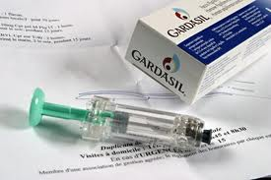
Inventions and Discoveries

Slide 9
Goal: Maximizing an Invention
Under Bayh-Dole, university and researcher may retain title to inventions made using federal research dollars
This system incentivizes the transfer of technology to the private sector for job creation
Any net licensing revenues to universities go back into more research and/or education, as well as patenting costs
Other benefit: initial development usually happens locally
2011 AUTM survey found that 73% of startups formed that year were in the same state where the research was conducted

Slide 10
Issues…
Is this product/invention patentable?
Is there a market for this invention?
Can we find a business interested in licensing, developing and commercializing this technology?
Can we start a new company?
Are there available dollars to help further develop the inventive technology?

Slide 11
Answering Those Questions
Technology Transfer Office
Professionals who analyze marketplace, develop business plans, and understand patent/licensing issues
Attorneys to help with patent application process
Experts in seeking venture/angel capital
Campus-based “accelerators,” incubators and proof-of-concept programs to help advance technology and boost fledgling start-up companies
Resources for connecting people and/or companies looking for new technology inventions; helping faculty further develop the technology pipeline.

Slide 12






STEPS FOR SUCCESS
Patents/licensing agreements
Proof of concept programs
Industry partnerships
Innovation/Entrepreneurship
Initiatives
Venture capital/
patenting costs
Business plans

Slide 13
Keys to Success
Dedicated technology transfer and support team
Understanding the marketplace and the local regional economy
Establishing university–private sector relationships that may include additional research funding
Bridging the gap between invention and commercialization
Strong patents
Outstanding researchers doing outstanding research
Long-term financial commitment

Slide 14
Positive Economic Impact
University licensing increased U.S. gross industry output by $836 billion between 1996 and 2010
These technologies support an estimated 3 million jobs in the economy
Tech transfer helped to create 671 new companies and 591 new products in 2011 alone
Direct correlation between amount of federal dollars invested in research and the innovations that research creates

Slide 15
Role for Policymakers
Provide strong and sustained basic research funding to provide pipeline of great ideas
Ensure that patent rights are protected for a given university, researcher, and the government
Encourage policies that attract venture capital support
Support SBIR/STTR and other translational initiatives
Support the Bayh-Dole Act
Do nothing to inhibit American ingenuity and innovation, which leads the world

Slide 16
Questions?
Contact info:
Vicki Loise, Executive Director
vloise@autm.net
847-559-0846

